Slide 1
Employee Data Analysis using Excel
STUDENT NAME:JAGADEESWARI.M
REGISTER NO:312203318[asunm161312203318]
DEPARTMENT:B.COM[GENERAL]
COLLEGE:PRINCE SHRI VENKATESHWARA ARTS AND SCIENCE COLLEGE

Slide 2
PROJECT TITLE
Employee Performance Analysis using Excel

Slide 3


AGENDA
Problem Statement
Project Overview
End Users
Our Solution and Proposition
Dataset Description
Modelling Approach
Results and Discussion
Conclusion
3/21/2024 Annual Review

Slide 4

PROBLEM STATEMENT
1)Clear Objectives and Goals
2)Skills and Competencies
3)Productivity and Efficiency
4)Quality of Work
5)Initiative and Innovation

Slide 5

PROJECT OVERVIEW
Develop an Excel-based system to track and analyze employee performance by creating sheets for employee data, performance metrics, and logs. Use formulas and conditional formatting for calculations and visualizations such as charts and dashboards. Regularly update performance data and generate periodic reports for insights and comparisons. Implement and train staff on the system, then review and adjust based on feedback. The goal is to enhance productivity and support data-driven decision-making.
.

Slide 6
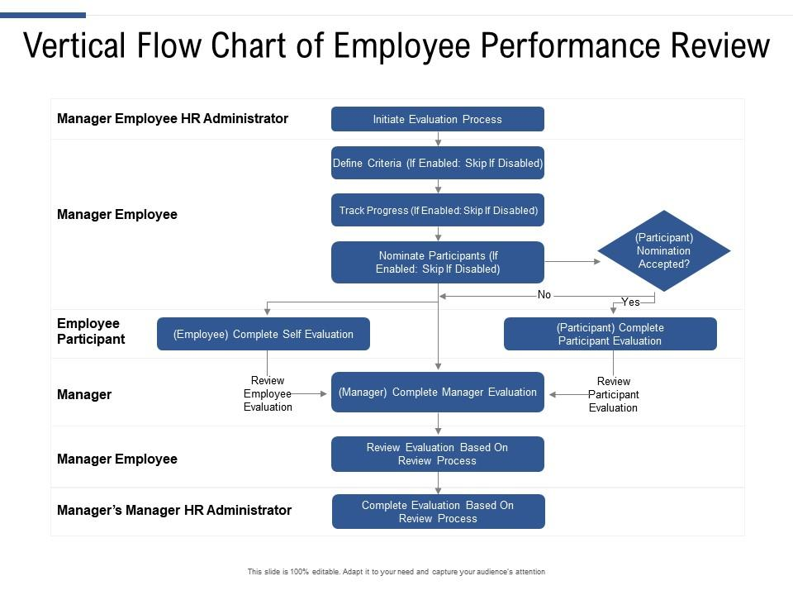

WHO ARE THE END USERS?

Slide 7

OUR SOLUTION AND ITS VALUE PROPOSITION
=IFS(Z8>=5,"VERY HIGH",Z8>=4,"HIGH",Z8>=3,"MED",TRUE,"LOW")

Slide 8
Dataset Description 1)Downloaded employee data set using- kaggle 2)Features used: Emp ID Name Gender Business cycle Performance score Current performance rating Performance level

Slide 9

THE "WOW" IN OUR SOLUTION
=IFS(Z8>=5,"VERY HIGH",Z8>=4,"HIGH",Z8>=3,"MED",TRUE,"LOW")
Pivot table,pie chart and bargraph
Highlighting the features
3/21/2024 Annual Review
<number>

Slide 10
MODELLING
1.Dowloaded employee data sheet from kaggle
2.selected 20 datasets in the downloaded data sheet and created a new data sheet
3.Highlighted the features used in the data sheet
4.select the employee performance and done the Eligibility status
5.create the pivot column and created pie chart and bar graph
6.Made analysis using the bargraph
<number>

Slide 11
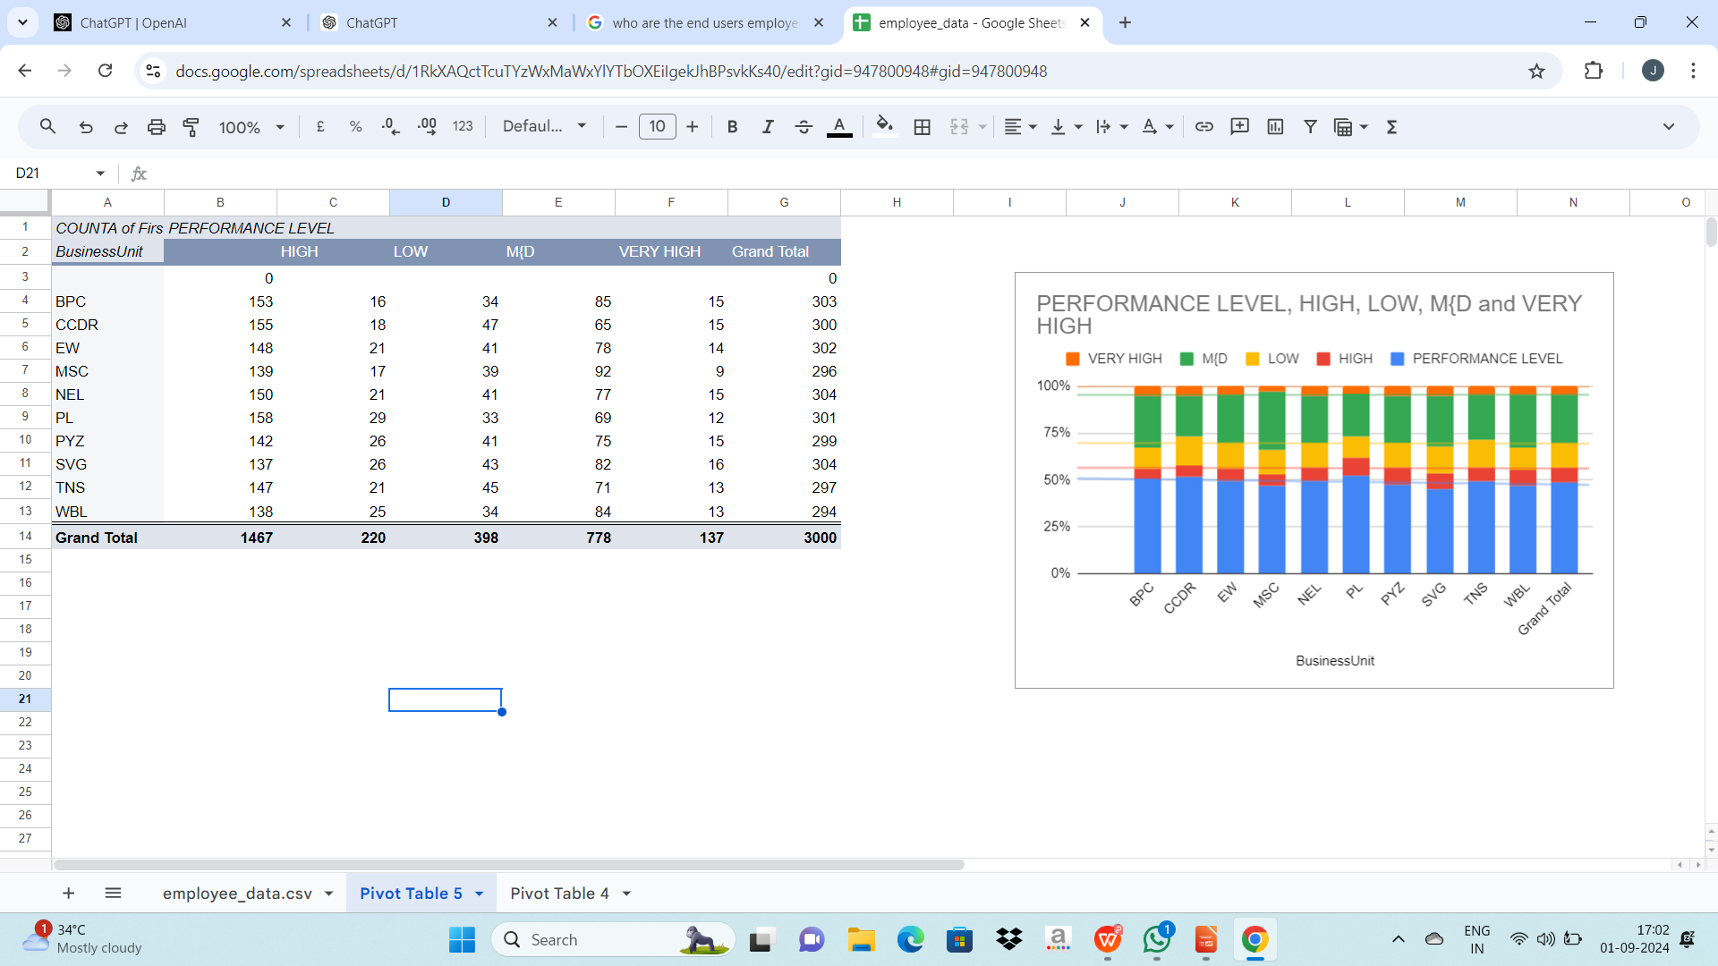
RESULT
<number>

Slide 12
CONCLUSION
Utilizing Excel for employee performance management provides a flexible and cost-effective solution for tracking and analyzing key metrics. By systematically organizing data, applying formulas, and leveraging visual tools like charts and dashboards, organizations can gain valuable insights into employee performance. This approach not only helps in identifying strengths and areas for improvement but also supports more informed decision-making and strategic planning. Regular updates and feedback-driven adjustments ensure that the system remains relevant and effective. Overall, Excel-based performance tracking enhances transparency, accountability, and productivity within the organization.

